Slide 1
Data Structures
Lecture 3
Linked List
Prantik Paul [PNP]
Lecturer
Department of Computer Science and Engineering
BRAC University

Slide 2
Array Problems
Fixed Capacity
Insert
Removal

Slide 3
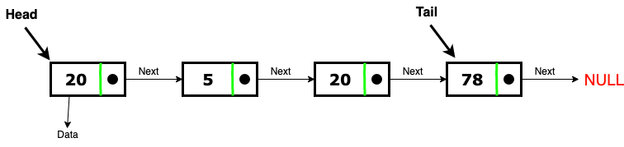
Solution? Linked List

Slide 4
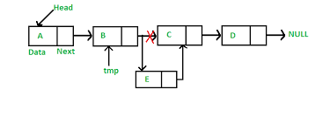
Linked List
Easy Insert

Slide 5
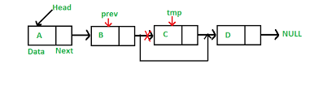
Linked List
Easy Removal

Slide 6
Linked List
Easy Resize

Slide 7
Linked List - Problems?
Random Access
Space

Slide 8
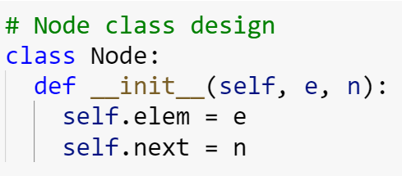
Linked List - Initialization

Slide 9
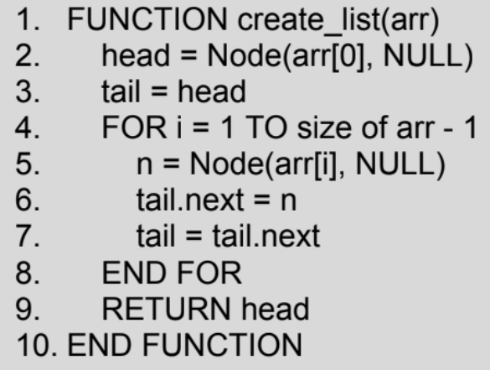
Linked List - Creation (From an Array)

Slide 10
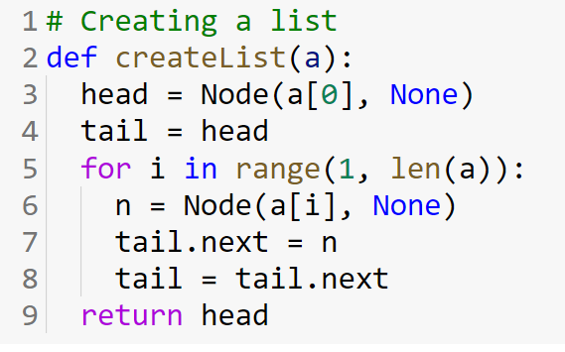
Linked List - Creation (From an Array)

Slide 11
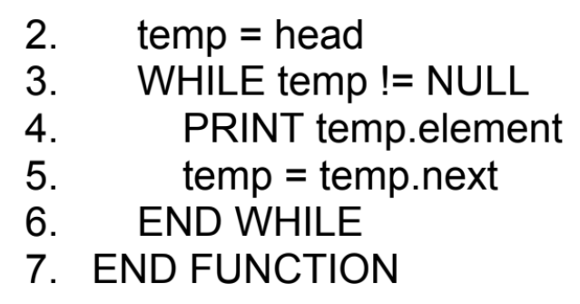
Linked List - Iteration

Slide 12
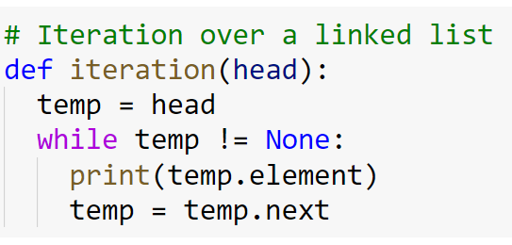
Linked List - Iteration

Slide 13
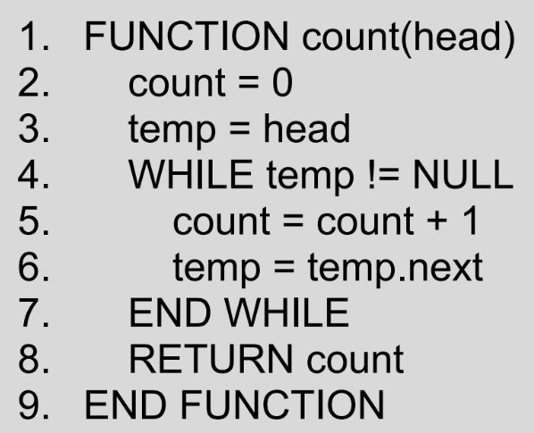
Linked List - Count

Slide 14
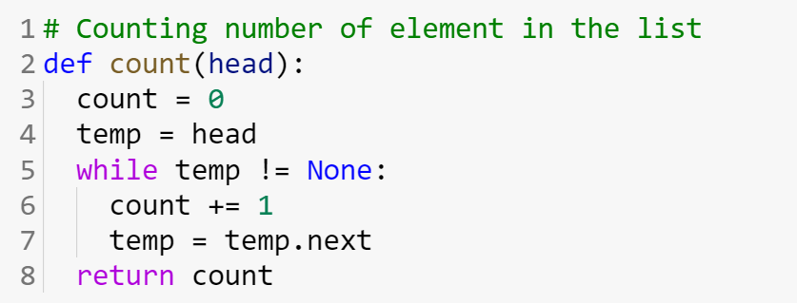
Linked List - Count

Slide 15
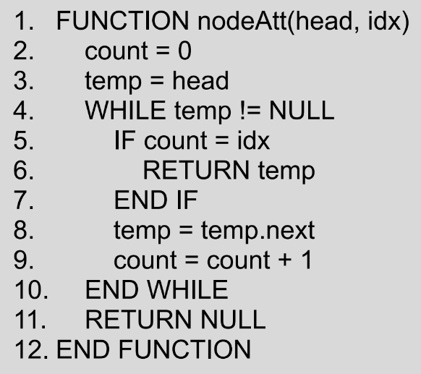
Linked List - Get Node

Slide 16
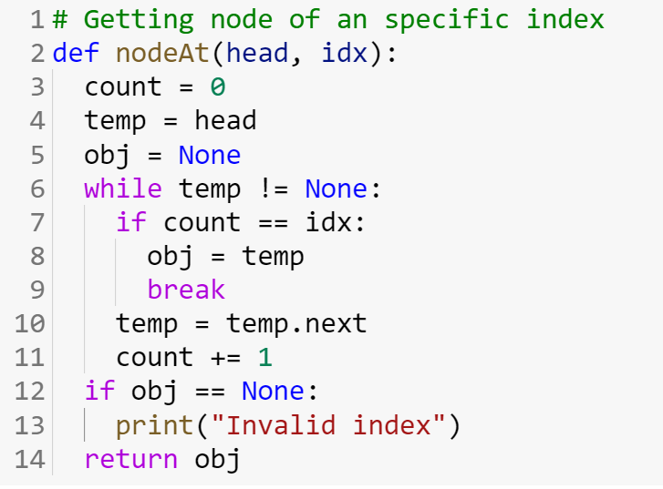
Linked List - Get Node

Slide 17
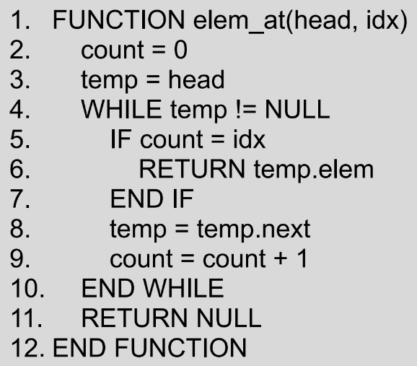
Linked List - Get Element

Slide 18
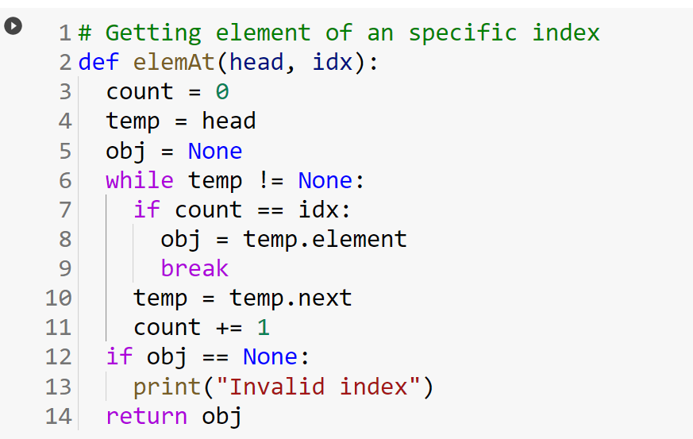
Linked List - Get Element

Slide 19
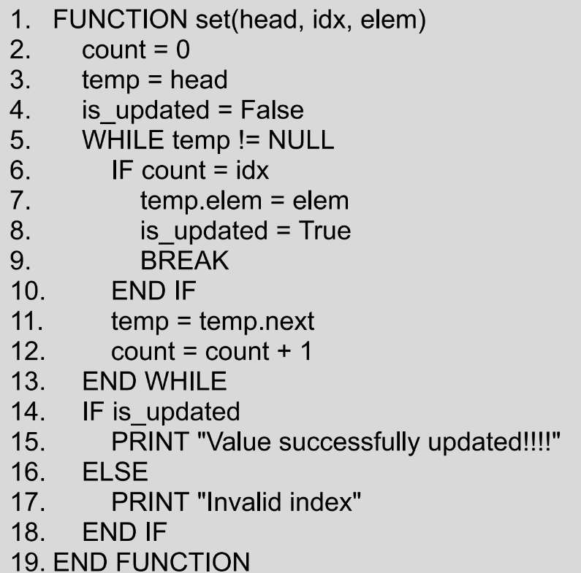
Linked List - Update Value at Index

Slide 20
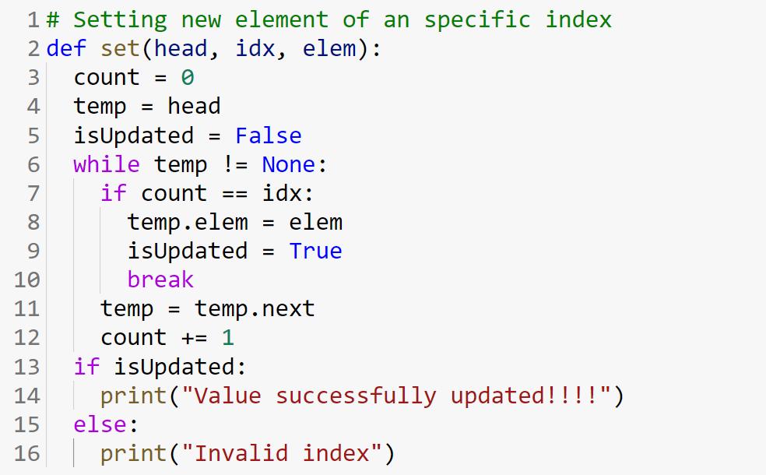
Linked List - Update Value at Index

Slide 21
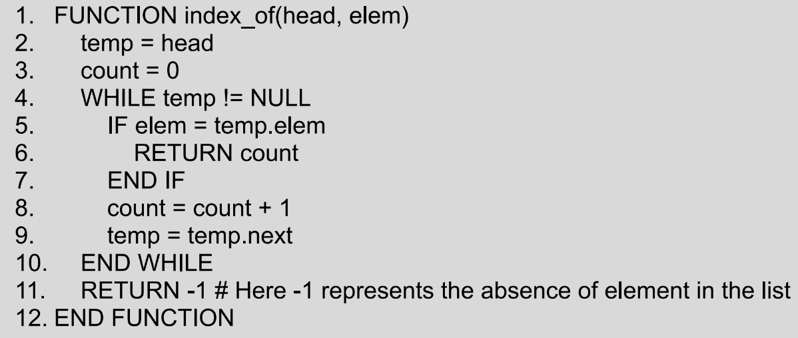
Linked List - Search Element

Slide 22
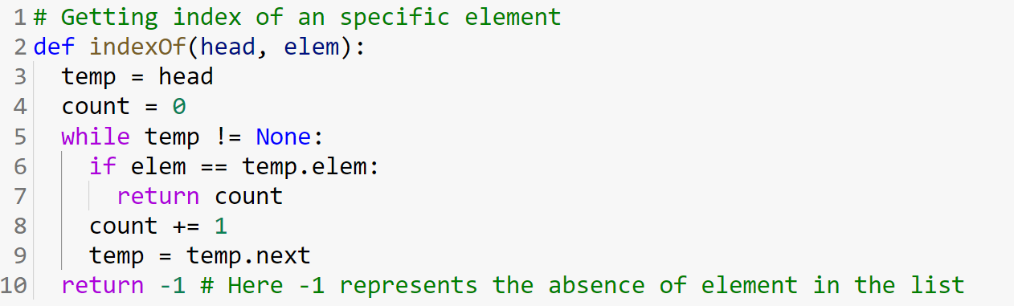
Linked List - Search Element

Slide 23
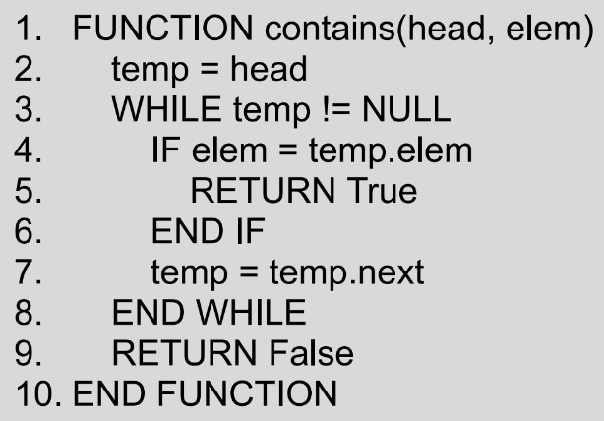
Linked List - Search Element

Slide 24
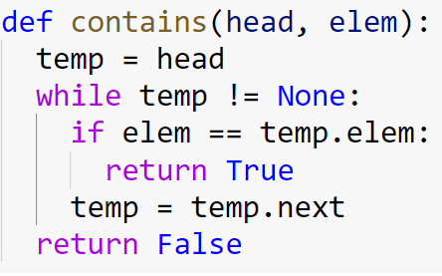
Linked List - Search Element

Slide 25
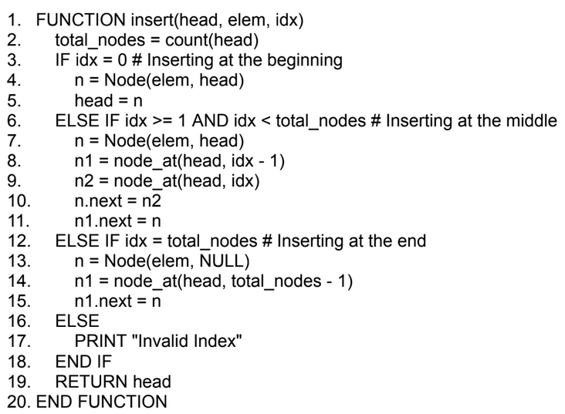
Linked List - Insert Element

Slide 26
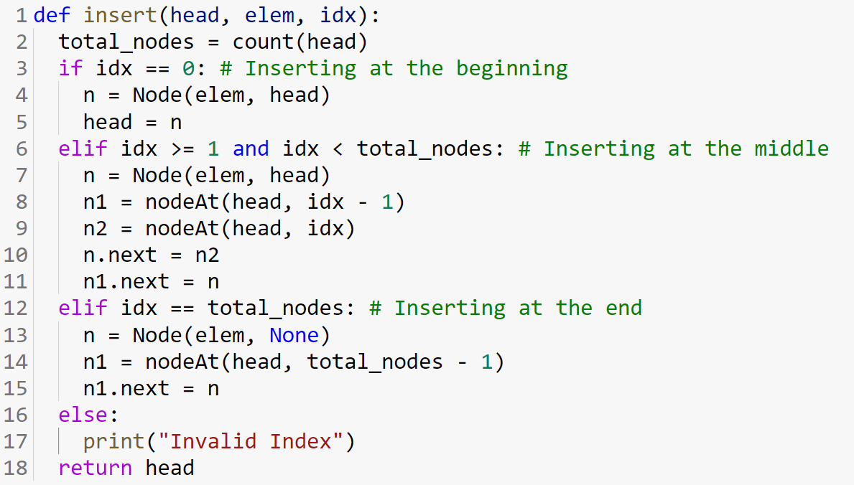
Linked List - Insert Element

Slide 27
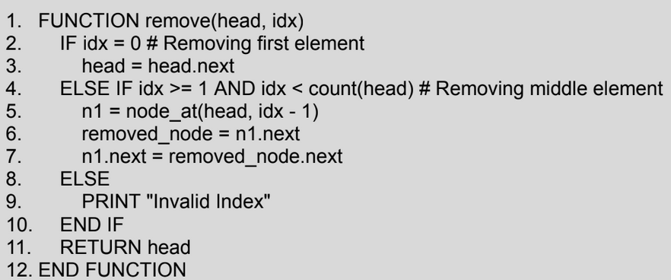
Linked List - Remove Element

Slide 28
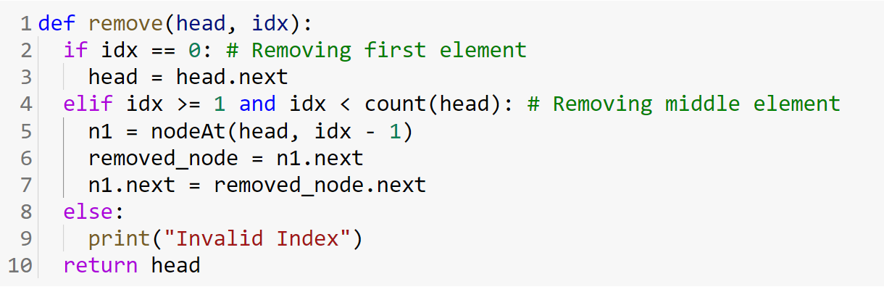
Linked List - Remove Element

Slide 29
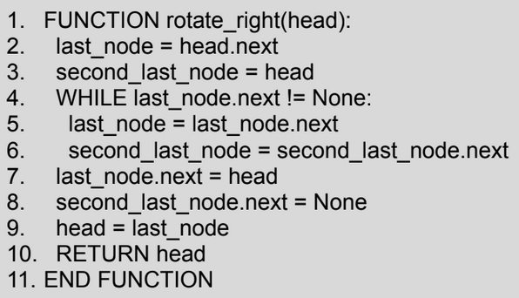
Linked List - Rotate Right

Slide 30
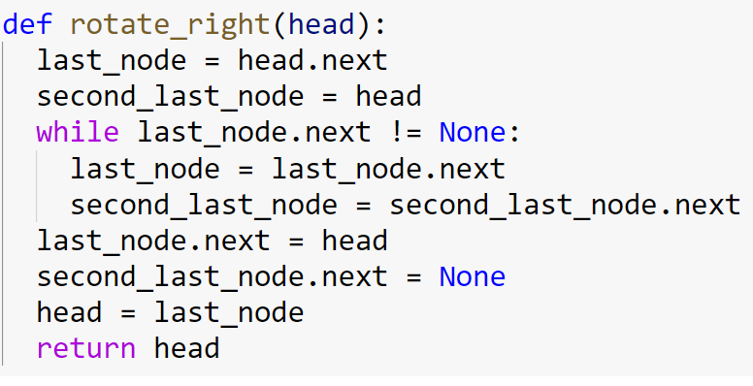
Linked List - Rotate Right

Slide 31
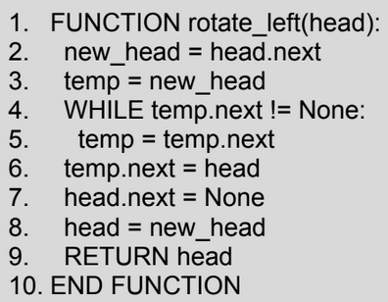
Linked List - Rotate Left

Slide 32
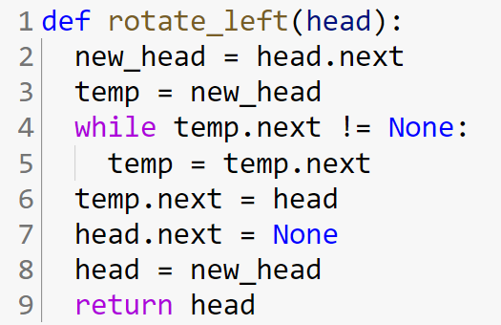
Linked List - Rotate Left

Slide 33
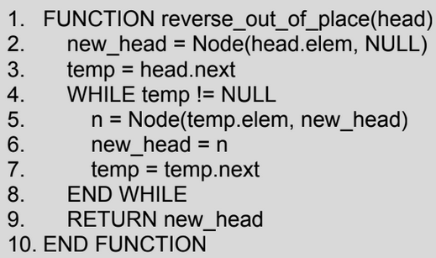
Linked List - Reverse List (Out of Place)

Slide 34
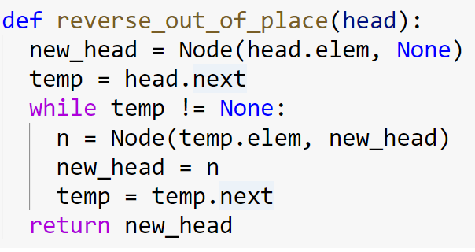
Linked List - Reverse List (Out of Place)

Slide 35
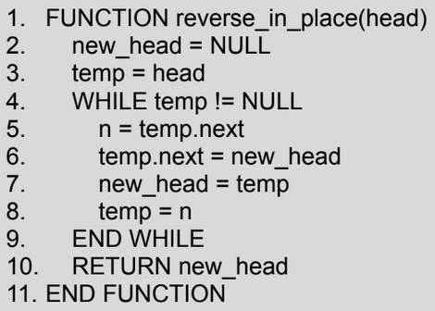
Linked List - Reverse List (In Place)

Slide 36
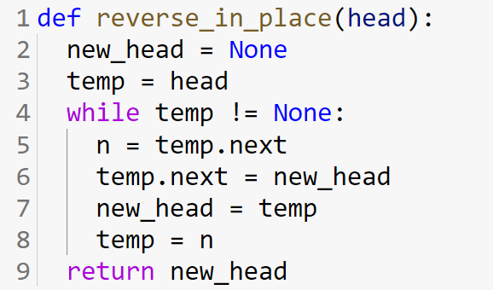
Linked List - Reverse List (In Place)

